Slide 1
Laboratory Safety and Procedures

Slide 2
Objective
Research and apply appropriate safety precautions (refer to ADE Guidelines) when designing and/or conducting scientific investigations
NS.10.PS.2
NS.11.B.2
NS.33.C.2

Slide 3
Lab Safety
http://vimeo.com/6272634

Slide 4
Lab Rules
Follow the instructor’s instructions at all times!
Work carefully and cautiously in the laboratory, using common sense and good judgment at all times.
Eating, drinking, applying cosmetics or lip balm, and handling contact lenses are strictly prohibited in the combined classroom/laboratory. Food, drinks (even in closed containers) are not to be brought into the room. Chewing gum is not allowed.
Long hair must be tied back, open toed shoes are strongly discouraged, and lab aprons and goggles must be worn when directed by the instructor.
Identify the location of all exits from the laboratory and from the building.

Slide 5
Lab Rules
Be familiar with the location and proper use of the eye wash station.
Report all injuries, spills, breakage of glass or other items, unsafe conditions, and accidents of any kind, no matter how minor, to the instructor immediately.
Lab tables must be clear of all items that are not necessary for the lab exercise.
Clean up your area after every laboratory session.
Horseplay in the lab will NOT be tolerated and will result in immediate office referral to all parties involved!

Slide 6
What can happen…

Slide 7
What can happen…
Fire
If there is a fire, major chemical spill or other emergency:
Contact the instructor, Mrs. Burton, or Mr. Ray immediately.
If evacuation is necessary:
take your personal belongings with you if possible
on your way out, close but do not lock the classroom door
go to the designated rally point away from this building
Location of rally point: Down north steps and outside in the north yard or at CJS is directed to move further away
If you are on fire, stop, drop and roll.

Slide 8
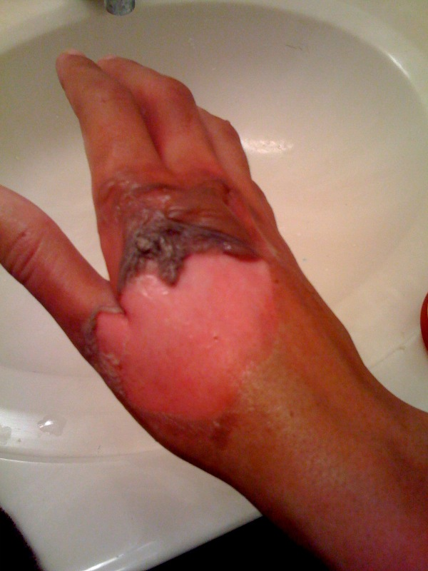
What can happen… Fire

Slide 9
What can happen…
Chemicals
Information about chemicals used in this laboratory can be found in Material Safety Data Sheets (MSDSs) and in a chemical inventory located in the chemical cabinet at the back of the class.
Label containers/test tubes if you are using more than one container per lab.
Inform your instructor immediately if a label is damaged in any way.
Read all labels and pay special attention to hazard information.

Slide 10
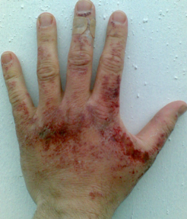
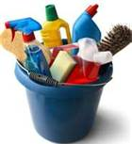
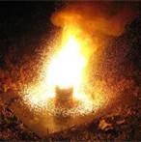
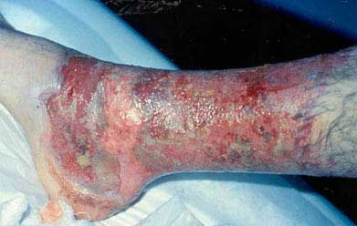
What can happen…
Chemicals
Flammable – can burn
Toxic - poisonous
Reactive – easily react with other chemicals (can be explosive)
Corrosive – can eat away at and destroy other substances

Slide 11
Safety Equipment
Personal Protective Equipment
Safety Eyewear:
You must wear safety eyewear (safety glasses or goggles) when directed to do so by the lab instructor or lab safety instructions. If you refuse to wear your eyewear, you will not be able to participate in the lab and may forfeit your lab grade for that day.
It is recommended that you do not wear any kind of contact lenses when working in the laboratory.
Gloves – You will be provided with nitrile and vinyl gloves for handling hazardous chemicals and biohazards. We do not carry latex gloves due to potential latex allergy.
Lab Coat – You may be required to wear a lab coat over your clothes when handling chemicals.

Slide 12
Safety Equipment
Personal Protective Equipment
Good Ideas:
Shoes – closed toe are recommended.
Tie back long hair in labs, especially around open flames.
Do not wear clothing with long, loose sleeves.
Wear natural fiber clothing (synthetic material melts into skin in a fire).
Remove watches, rings, and bracelets during lab activities involving chemicals

Slide 13
Lab Safety Equipment
Eyewash is located on the wall in between the closet and the bookshelf. If a chemical is splashed or rubbed into your eyes you must use eyewash for at least 15 minutes with your eyes held open. Someone will help you with this.

Slide 14
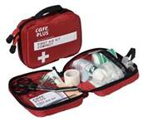
Lab Safety Equipment
Fire extinguishers are located in each hallway.
If a person is experiencing electrical shock from touching wires or equipment, use a belt or other non-conducting material to pull them away from the electrical source.
First aid kits are located in the main office on the first floor.
Only minor cuts and burns will be treated in the school office. Serious injuries must be treated in a medical facility. Emergency Medical Services (EMS) will be called if you are injured.
The instructor must fill out a report describing your injury.

Slide 15
General Housekeeping
Never dispose of anything in lab without prior direction from the instructor.
Regular trash container is located in the front of the room.
Notify the instructor immediately in case of broken glass. The instructor will remove and discard any broken glass.
Put correct lids back on bottles and containers immediately after use.
Do not put excess chemicals back into original containers.
Dispose of chemicals and waste only as directed by the instructor.
Wash your hands prior to leaving lab.
Assume that chemicals used in lab are corrosive, irritating, and toxic.

Slide 16
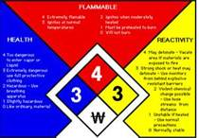
Common Warning Labels

